Slide 1



Iron Kaggle
Tiago Ferreira da Silva
Saúl Verdú Vicente

Slide 2
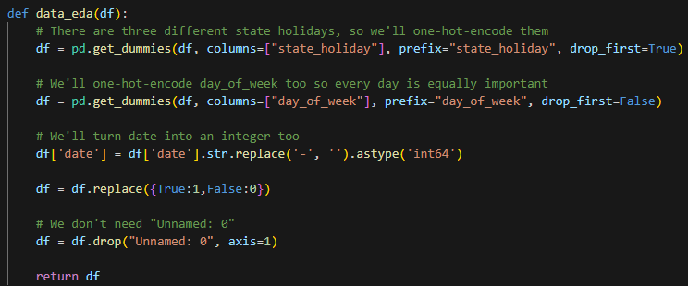
EDA

Slide 3
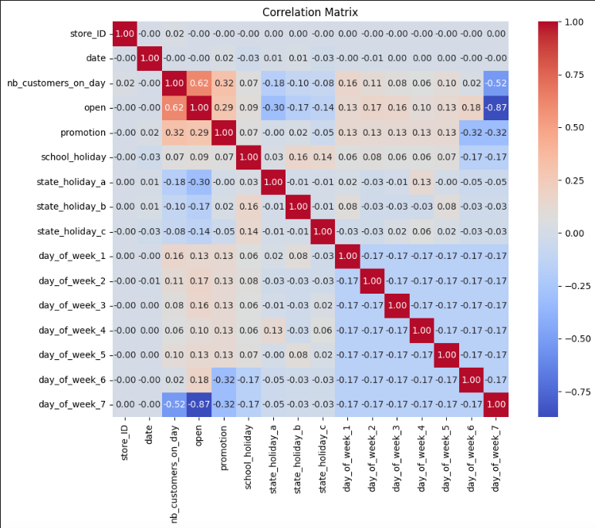
Correlation Matrix

Slide 4
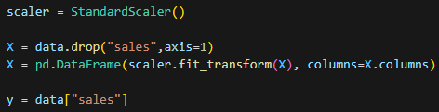
Feature Scaling (Standardization)

Slide 5
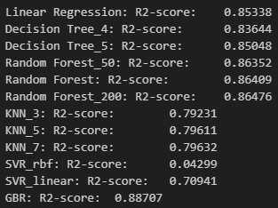
Model Cross Validation

Slide 6
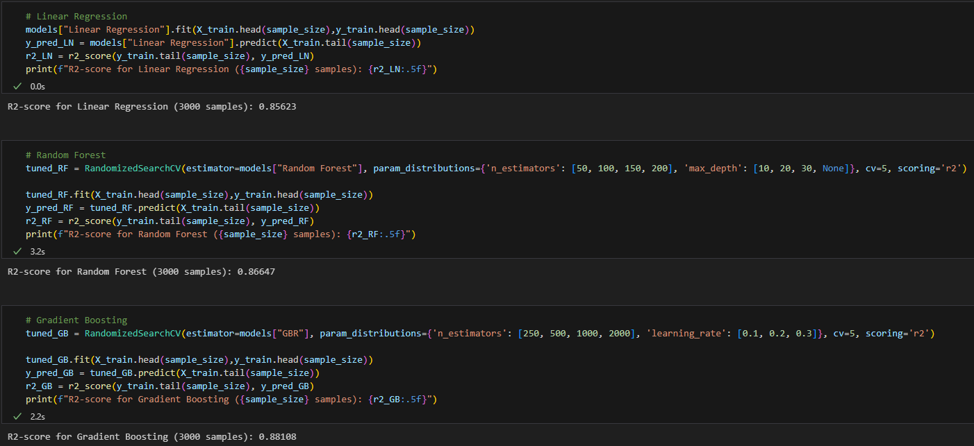
Hyperparameter Tuning

Slide 7
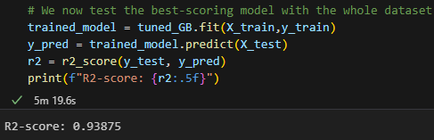
Model Predictions

Slide 8
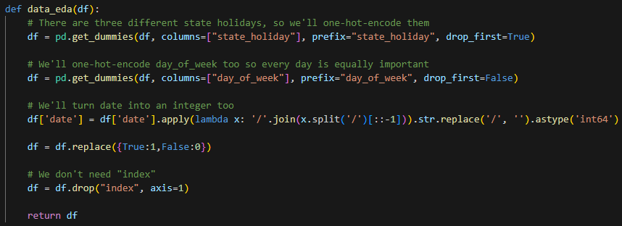
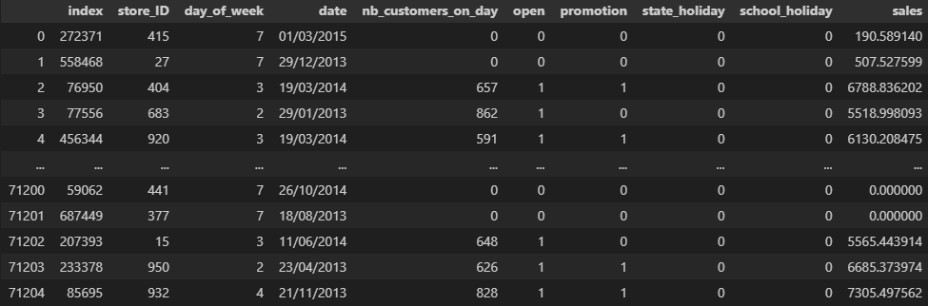
Real Data Predictions

